Slide 1
Knowledge Representation using First-Order Logic
CHAPTER 8
Oliver Schulte
Notes:
Demo in aispace: look for father(isaac) using ask(father(isaac,X)) and similar.
Note the term “definite clause”.
Show how you can retrieve data, and draw inferences.
Eg. Enrolled(jane,312). Indept(jane,match). CS_course©.

Slide 2
Outline
What is First-Order Logic (FOL)?
  Syntax and semantics
Using FOL
Wumpus world in FOL
Knowledge engineering in FOL

Slide 3
Limitations of propositional logic
☹ Propositional logic has limited expressive power
  unlike natural language
  E.g., cannot say "pits cause breezes in adjacent squares“
    except by writing one sentence for each square

Slide 4
Wumpus World and propositional logic
Find Pits in Wumpus world
  B_{x,y} ⇔ (P_{x,y+1} ∨ P_{x,y-1} ∨ P_{x+1,y} ∨ P_{x-1,y}) (Breeze next to Pit) 16 rules
Find Wumpus
  S_{x,y} ⇔ (W_{x,y+1} ∨ W_{x,y-1} ∨ W_{x+1,y} ∨ W_{x-1,y}) (stench next to Wumpus) 16 rules
At least one Wumpus in world
  W_{1,1} ∨ W_{1,2} ∨ … ∨ W_{4,4} (at least 1 Wumpus) 1 rule
At most one Wumpus
  ¬ W_{1,1} ∨ ¬ W_{1,2 (155 RULES)}
Notes:
At least one: more easily written as w_{11} \implies not w_{12} …..

Slide 5
First-Order Logic
Propositional logic assumes that the world contains facts.
First-order logic (like natural language) assumes the world contains
  Objects: people, houses, numbers, colors, baseball games, wars, …
  Relations: red, round, prime, brother of, bigger than, part of, comes between, …
  Functions: father of, best friend, one more than, plus, …

Slide 6
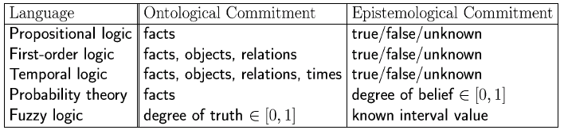
Logics in General
Ontological Commitment:
  What exists in the world — TRUTH
  PL : facts hold or do not hold.
  FOL : objects with relations between them that hold or do not hold
Epistemological Commitment:
  What an agent believes about facts — BELIEF

Slide 7
Syntax of FOL: Basic elements
Constant Symbols:
  Stand for objects
  e.g., KingJohn, 2, UCI,...
Predicate Symbols
  Stand for relations
  E.g., Brother(Richard, John), greater_than(3,2)...
Function Symbols
  Stand for functions
  E.g., Sqrt(3), LeftLegOf(John),...

Slide 8
Syntax of FOL: Basic elements
Constants KingJohn, 2, UCI,...
Predicates Brother, >,...
Functions Sqrt, LeftLegOf,...
Variables x, y, a, b,...
Connectives ¬, ⇒, ∧, ∨, ⇔
Equality =
Quantifiers ∀, ∃

Slide 9
Relations
Some relations are properties: they state
some fact about a single object: Round(ball), Prime(7).
n-ary relations state facts about two or more objects: Married(John,Mary), LargerThan(3,2).
Some relations are functions: their value is another object: Plus(2,3), Father(Dan).

Slide 10
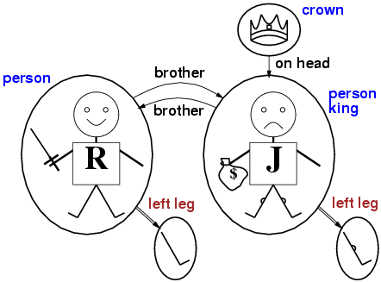
Models for FOL: Graphical Example
Notes:
This kind of graph is called a Gaifman graph for the model.

Slide 11

Tabular Representation
A FOL model is basically equivalent to a relational database instance.
Historically, the relational data model comes from FOL.
Student
s-id | Intelligence | Ranking
Jack | 3 | 1
Kim | 2 | 1
Paul | 1 | 2
Course
c-id | Rating | Difficulty
101 | 3 | 1
102 | 2 | 2
Professor
p-id | Popularity | Teaching-a
Oliver | 3 | 1
Jim | 2 | 1
RA
s-id | p-id | Salary | Capability
Jack | Oliver | High | 3
Kim | Oliver | Low | 1
Paul | Jim | Med | 2
Registration
s-id | c.id | Grade | Satisfaction
Jack | 101 | A | 1
Jack | 102 | B | 2
Kim | 102 | A | 1
Paul | 101 | B | 1
Notes:
Codd 1970s, introduces relational data model.

Slide 12
Terms
Term = logical expression that refers to an object.
There are 2 kinds of terms:
  constant symbols: Table, Computer
  function symbols: LeftLeg(Pete), Sqrt(3), Plus(2,3) etc
Functions can be nested:
  Pat_Grandfather(x) = father(father(x))
Terms can contain variables.
No variables = ground term.

Slide 13
Atomic Sentences
Atomic sentences state facts using terms and predicate symbols
  P(x,y) interpreted as “x is P of y”
Examples:
LargerThan(2,3) is false.
Brother_of(Mary,Pete) is false.
Married(Father(Richard), Mother(John)) could be true or false
Note: Functions do not state facts and form no sentence:
  Brother(Pete) refers to John (his brother) and is neither true nor false.
Brother_of(Pete,Brother(Pete)) is True.
Binary relation
Function

Slide 14
Complex Sentences
We make complex sentences with connectives (just like in propositional logic).
property
binary
relation
function
objects
connectives

Slide 15
More Examples
Brother(Richard, John) ∧ Brother(John, Richard)
King(Richard) ∨ King(John)
King(John) => ¬ King(Richard)
LessThan(Plus(1,2) ,4) ∧ GreaterThan(1,2)
(Semantics are the same as in propositional logic)

Slide 16
Variables
Person(John) is true or false because we give it a single argument ‘John’
We can be much more flexible if we allow variables which can take on values in a domain. e.g., all persons x, all integers i, etc.
  E.g., can state rules like Person(x) => HasHead(x)
  or Integer(i) => Integer(plus(i,1)

Slide 17
Universal Quantification ∀
∀ means “for all”
Allows us to make statements about all objects that have certain properties
Can now state general rules:
  ∀ x King(x) => Person(x)
  ∀ x Person(x) => HasHead(x)
  i Integer(i) => Integer(plus(i,1))
  Note that
  x King(x) ∧ Person(x) is not correct!
  This would imply that all objects x are Kings and are People
  ∀ x King(x) => Person(x) is the correct way to say

Slide 18
Existential Quantification ∃
∃ x means “there exists an x such that….” (at least one object x)
Allows us to make statements about some object without naming it
Examples:
  ∃ x King(x)
  ∃ x Lives_in(John, Castle(x))
  ∃ i Integer(i) ∧ GreaterThan(i,0)
  Note that ∧ is the natural connective to use with ∃
  (And => is the natural connective to use with ∀ )

Slide 19
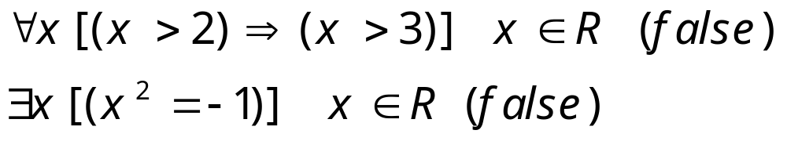
More examples
For all real x, x>2 implies x>3.
There exists some real x whose square is minus 1.
UBC AI space demo for rules

Slide 20
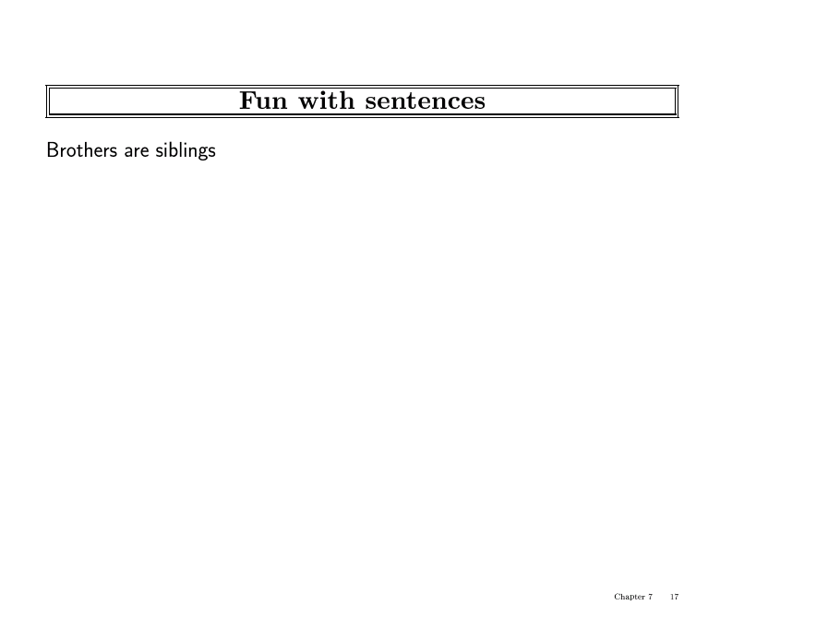

Slide 21
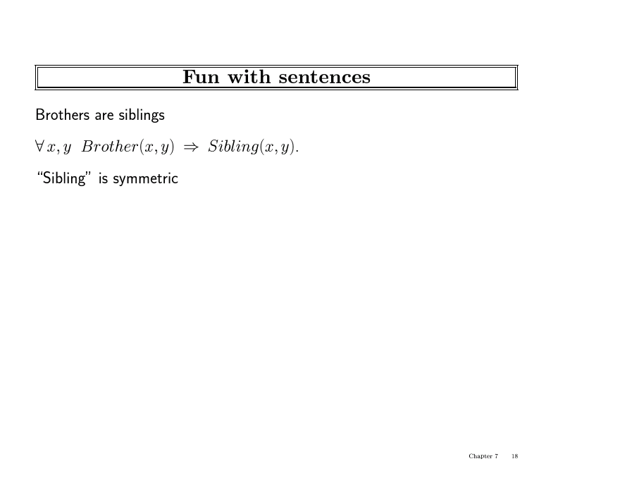

Slide 22
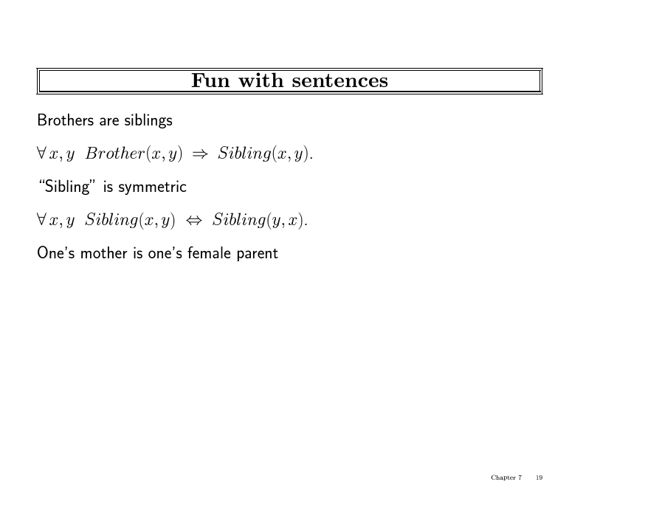

Slide 23
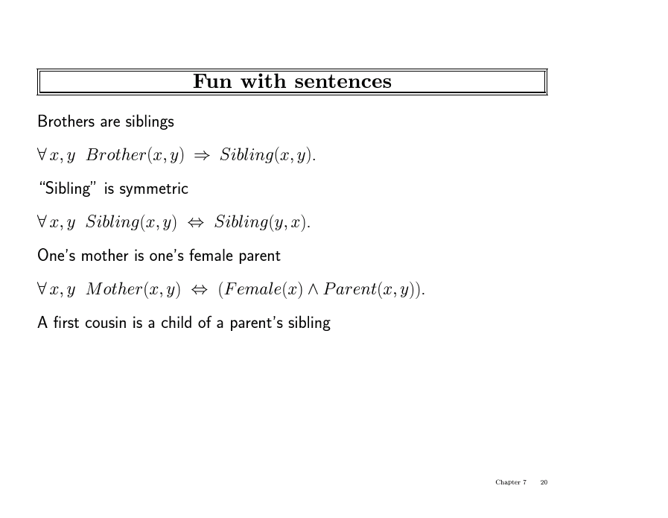

Slide 24
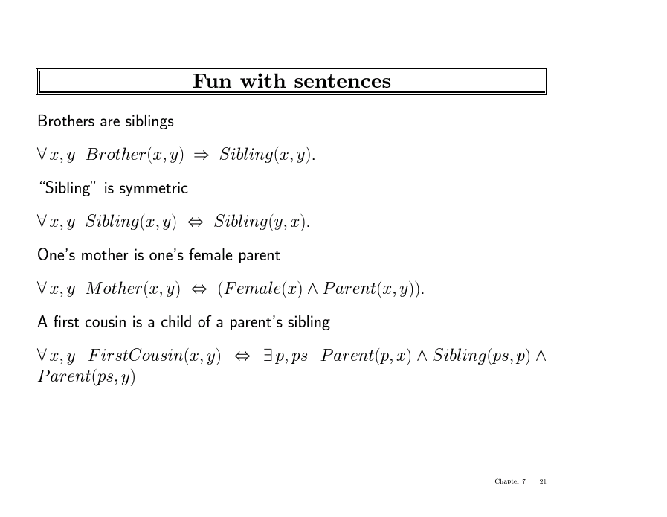

Slide 25
Combining Quantifiers
∀ x ∃ y Loves(x,y)
  For everyone (“all x”) there is someone (“y”) that they love.
y ∀ x Loves(x,y)
- there is someone (“y”) who is loved by everyone
Clearer with parentheses: ∃ y ( ∀ x Loves(x,y) )
Notes:
Make consistent with text.

Slide 26
Duality: Connections between Quantifiers
Asserting that all x have property P is the same as asserting that
there does not exist any x that does’t have the property P
∀ x Likes(x, 271 class) ⬄ ¬ ∃ x ¬ Likes(x, 271 class)
In effect:
- ∀ is a conjunction over the universe of objects
- ∃ is a disjunction over the universe of objects
Thus, DeMorgan’s rules can be applied
Notes:
Imagine you have a query language where you have one quantifier but not the other.
This is ane xample of duality. Same for
Intersect, union in set theory.
Meet, join in lattice theory.
Possible, necessary in modal logic.
Assert vs. deny

Slide 27
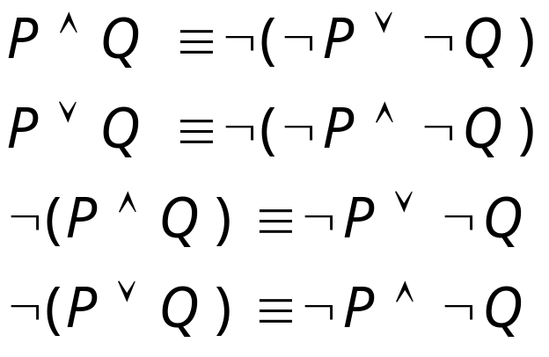
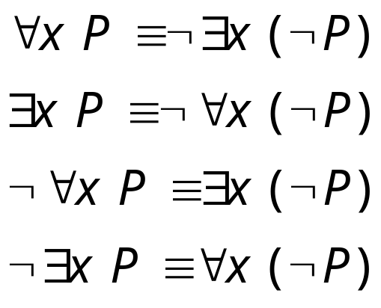
De Morgan’s Law for Quantifiers
De Morgan’s Rule
Generalized De Morgan’s Rule
Rule is simple: if you bring a negation inside a disjunction or a conjunction,
always switch between them (or →and, and → or).

Slide 28
Exercise
Formalize the sentence
“Jack has reserved all red boats.”
Apply De Morgan’s duality laws to this sentence.

Slide 29


Using FOL
We want to TELL things to the KB, e.g.
TELL(KB, )
TELL(KB, King(John) )
These sentences are assertions
We also want to ASK things to the KB,
ASK(KB, )
these are queries or goals
The KB should output x where Person(x) is true: {x/John,x/Richard,...}

Slide 30
FOL Planning in Wumpus World
Typical percept sentence:
Percept([Stench,Breeze,Glitter,None,None],5)
Actions:
Turn(Right), Turn(Left), Forward, Shoot, Grab, Release, Climb
To determine best action, construct query:
∀ a BestAction( a,5).
ASK solves this and returns {a/Grab}
  And TELL about the action.
Using logical queries is a general way to do planning.
Would also work for missionaries and cannibals.

Slide 31
Knowledge Base for Wumpus World
Perception
  ∀s,g,t Percept([s, Breeze,g],t) ⇒ Breeze(t)
  ∀s,b,t Percept([s,b,Glitter],t) ⇒ Glitter(t)
Reflex
  ∀t Glitter(t) ⇒ BestAction(Grab,t)
Reflex with internal state
  ∀t Glitter(t) ∧¬Holding(Gold,t) ⇒ BestAction(Grab,t)
  Holding(Gold,t) is not a percept: keep track of change.

Slide 32
Deducing hidden properties
Environment definition:
  ∀x,y,a,b Adjacent([x,y],[a,b]) ⇔ [a,b] ∈ {[x+1,y], [x-,y],[x,y+1],[x,y-1]}
  Properties of locations:
  ∀s,t At(Agent,s,t) ∧ Breeze(t) ⇒ Breezy(s)
  Location s and time t
Squares are breezy near a pit:
  Diagnostic rule---infer cause from effect
    ∀s Breezy(s) ⇔ ∃ r Adjacent(r,s) ∧ Pit(r)
  Causal rule---infer effect from cause.
    ∀r Pit(r) ⇒ [∀s Adjacent(r,s) ⇒ Breezy(s)]
Notes:
We revisit diagnostic rules when we come to probabilistic reasoning.

Slide 33
Set Theory in First-Order Logic
Can we define set theory using FOL?
- individual sets, union, intersection, etc
Answer is yes.
Basics:
- empty set = constant = { } and elements x, y …
- unary predicate Set(S), true for sets
- binary predicates:
member(x,s) x ∈ s (true if x is a member of the set x)
subset(s₁,s₂) s₁ ⊆ s₂ (true if s1 is a subset of s2)

Slide 34
Set Theory in First-Order Logic
binary functions:
Intersect(s₁,s₂) s₁ ∩ s₂
Union(s₁,s₂) s₁ ∪ s₂
Adjoin(x,s) adding x to set s {x|s}
The only sets are the empty set and sets made by adjoining an element to a set
∀s Set(s) ⇔ (s = {} ) ∨ (∃x,s₂ Set(s₂) ∧ s = Adjoin(x, s₂))
The empty set has no elements adjoined to it
¬∃x,s Adjoin(x, s) = {}

Slide 35
A Possible Set of FOL Axioms for Set Theory
Adjoining an element already in the set has no effect
∀x,s member(x,s) ⇔ s = Adjoin(x, s)
A set is a subset of another set iff all the first set’s members are members of the 2nd set
∀s₁,s₂ subset(s₁,s₂) ⇔ (∀x member(x ,s₁ ) ⇒ member(x , s₂ )
Two sets are equal iff each is a subset of the other
∀s₁,s₂ (s₁ = s₂) ⇔ (subset(s₁,s₂) ∧ subset(s₂ , s₁))

Slide 36
A Possible Set of FOL Axioms for Set Theory
An object is in the intersection of 2 sets only if a member of both
∀x,s₁,s₂ x ∈ intersect(s₁ , s₂) ⇔ (member(x ,s₁ ) ∧ member(x ,s₂ )
An object is in the union of 2 sets only if a member of either
∀x,s₁,s₂ x ∈ union(s₁ , s₂) ⇔ (member(x ,s₁ ) ∨ member(x ,s₂ )

Slide 37
Knowledge engineering in FOL
Identify the task
Assemble the relevant knowledge
Decide on a vocabulary of predicates, functions, and constants
Encode general knowledge about the domain
Encode a description of the specific problem instance
Pose queries to the inference procedure and get answers
Debug the knowledge base.
See text for full example: electric circuit knowledge base.

Slide 38
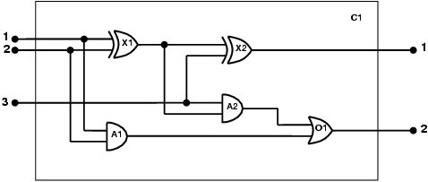
The electronic circuits domain
One-bit full adder
Possible queries:
- does the circuit function properly?
- what gates are connected to the first input terminal?
- what would happen if one of the gates is broken?
and so on

Slide 39
The electronic circuits domain
Identify the task
  Does the circuit actually add properly?
Assemble the relevant knowledge
  Composed of wires and gates; Types of gates (AND, OR, XOR, NOT)
  Irrelevant: size, shape, color, cost of gates
Decide on a vocabulary
  Alternatives:
    Type(X₁) = XOR (function)
    Type(X₁, XOR) (binary predicate)
    XOR(X₁)
    (unary predicate)

Slide 40
The electronic circuits domain
Encode general knowledge of the domain
  ∀t₁,t₂ Connected(t₁, t₂) ⇒ Signal(t₁) = Signal(t₂)
  ∀t Signal(t) = 1 ∨ Signal(t) = 0
  1 ≠ 0
  ∀t₁,t₂ Connected(t₁, t₂) ⇒ Connected(t₂, t₁)
  ∀g Type(g) = OR ⇒ Signal(Out(1,g)) = 1 ⇔ ∃n Signal(In(n,g)) = 1
  ∀g Type(g) = AND ⇒ Signal(Out(1,g)) = 0 ⇔ ∃n Signal(In(n,g)) = 0
  ∀g Type(g) = XOR ⇒ Signal(Out(1,g)) = 1 ⇔ Signal(In(1,g)) ≠ Signal(In(2,g))
  ∀g Type(g) = NOT ⇒ Signal(Out(1,g)) ≠ Signal(In(1,g))

Slide 41
The electronic circuits domain
Encode the specific problem instance
  Type(X₁) = XOR Type(X₂) = XOR
  Type(A₁) = AND Type(A₂) = AND
  Type(O₁) = OR
  Connected(Out(1,X₁),In(1,X₂)) Connected(In(1,C₁),In(1,X₁))
  Connected(Out(1,X₁),In(2,A₂)) Connected(In(1,C₁),In(1,A₁))
  Connected(Out(1,A₂),In(1,O₁)) Connected(In(2,C₁),In(2,X₁))
  Connected(Out(1,A₁),In(2,O₁)) Connected(In(2,C₁),In(2,A₁))
  Connected(Out(1,X₂),Out(1,C₁)) Connected(In(3,C₁),In(2,X₂))
  Connected(Out(1,O₁),Out(2,C₁)) Connected(In(3,C₁),In(1,A₂))

Slide 42
The electronic circuits domain
Pose queries to the inference procedure
  What are the possible sets of values of all the terminals for the adder circuit?
∃i₁,i₂,i₃,o₁,o₂ Signal(In(1,C_1)) = i₁ ∧ Signal(In(2,C₁)) = i₂ ∧ Signal(In(3,C₁)) = i₃ ∧ Signal(Out(1,C₁)) = o₁ ∧ Signal(Out(2,C₁)) = o₂
Debug the knowledge base
  May have omitted assertions like 1 ≠ 0

Slide 43
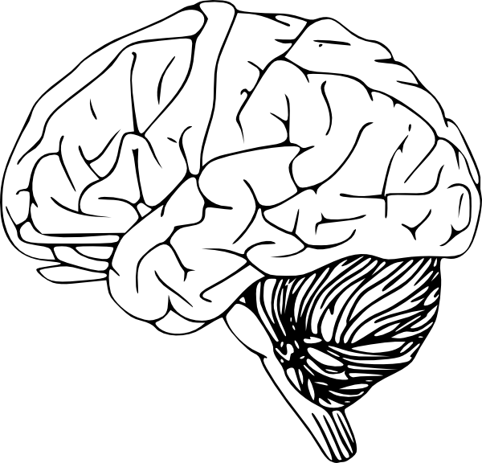
Expressiveness vs. Tractability
There is a fundamental trade-off between expressiveness and tractability in Artificial Intelligence.
Similar, even more difficult issues with probabilistic reasoning (later).
Reasoning power
Horn clause
Prolog
Description Logic
FOL
????
Valiant
expressiveness

Slide 44
Summary
First-order logic:
  Much more expressive than propositional logic
  Allows objects and relations as semantic primitives
  Universal and existential quantifiers
  syntax: constants, functions, predicates, equality, quantifiers
Knowledge engineering using FOL
  Capturing domain knowledge in logical form
Inference and reasoning in FOL
  Next lecture.
FOL is more expressive but harder to reason with: Undecidable, Turing-complete.

Slide 45
Inference in First-Order Logic

